Slide 1


Mohammad Javan Samboeputra Herlambang
22 October 2-25

Slide 2

Outline
Executive Summary
Introduction
Methodology
Results
Conclusion
Appendix

Slide 3
Executive Summary
Summary of methodologies
Performed Exploratory Data Analysis (EDA) to identify key launch factors influencing landing success.
Applied feature engineering with one-hot encoding and data standardization using StandardScaler.
Split the dataset into 80% training and 20% testing sets.
Trained and tuned four supervised ML models using GridSearchCV (10-fold CV): Logistic Regression, SVM, Decision Tree, and KNN.
Assessed performance using validation accuracy and confusion matrices.
Summary of all results
Test sample size: 18 records
Best SVM kernel: sigmoid
Top test accuracy: Decision Tree – 894.4%
Model ranking (by validation accuracy):
Decision Tree – 87.5%
SVM (sigmoid) 84.8%
Logistic Regression – 84.6%%
KNN – 82.1%
Conclusion: Decision Tree Classifier delivered the most accurate and reliable predictions for SpaceX Falcon 9 landing outcomes.

Slide 4
Introduction
Project background and context
SpaceX’s goal of reducing space launch costs relies heavily on reusable rockets, making booster landing success critical.This project analyzes public SpaceX launch data to build a predictive model that estimates Falcon 9 landing success based on mission parameters.It represents Part 5 of the IBM Data Science Capstone, focusing on applying machine learning after prior EDA and feature engineering steps.
Problems to answers
Which mission and payload factors most influence Falcon 9 landing success?
Can landing outcomes be accurately predicted using launch features?
Which machine learning model provides the highest predictive accuracy?

Slide 5

Section 1

Slide 6
Methodology
Executive Summary
Data collection methodology:
Combined SpaceX REST API (JSON → normalized to DataFrame) with web scraping (Wikipedia tables via BeautifulSoup) to enrich launch metadata (payload, booster, orbit, outcomes).
Perform data wrangling
Cleaned nulls/inconsistencies, standardized units, parsed dates, engineered Class label (1 = landed, 0 = not landed), and harmonized categorical fields (site, orbit, booster).
Perform exploratory data analysis (EDA) using visualization and SQL
Perform interactive visual analytics using Folium and Plotly Dash
Perform predictive analysis using classification models
Pipeline: preprocess → train baseline → hyperparameter grid search → select best via CV score → test set accuracy & confusion matrix → compare models; best model: Decision Tree (≈ 83.33% test accuracy).

Slide 7
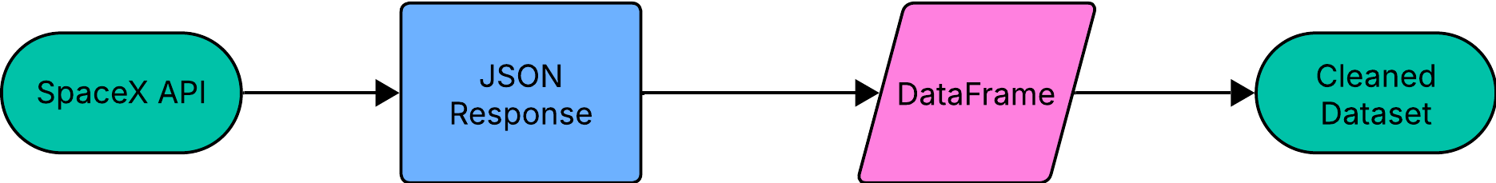
Data Collection
Data collected from SpaceX REST API using requests and pandas.json_normalize()
Supplemented with web scraping from SpaceX Wikipedia pages using BeautifulSoup
Combined datasets stored and cleaned in Jupyter notebooks for consistency
Data sources included launch outcomes, payload mass, booster version, and orbit type
Raw data transformed into a structured DataFrame for EDA and model training

Slide 8
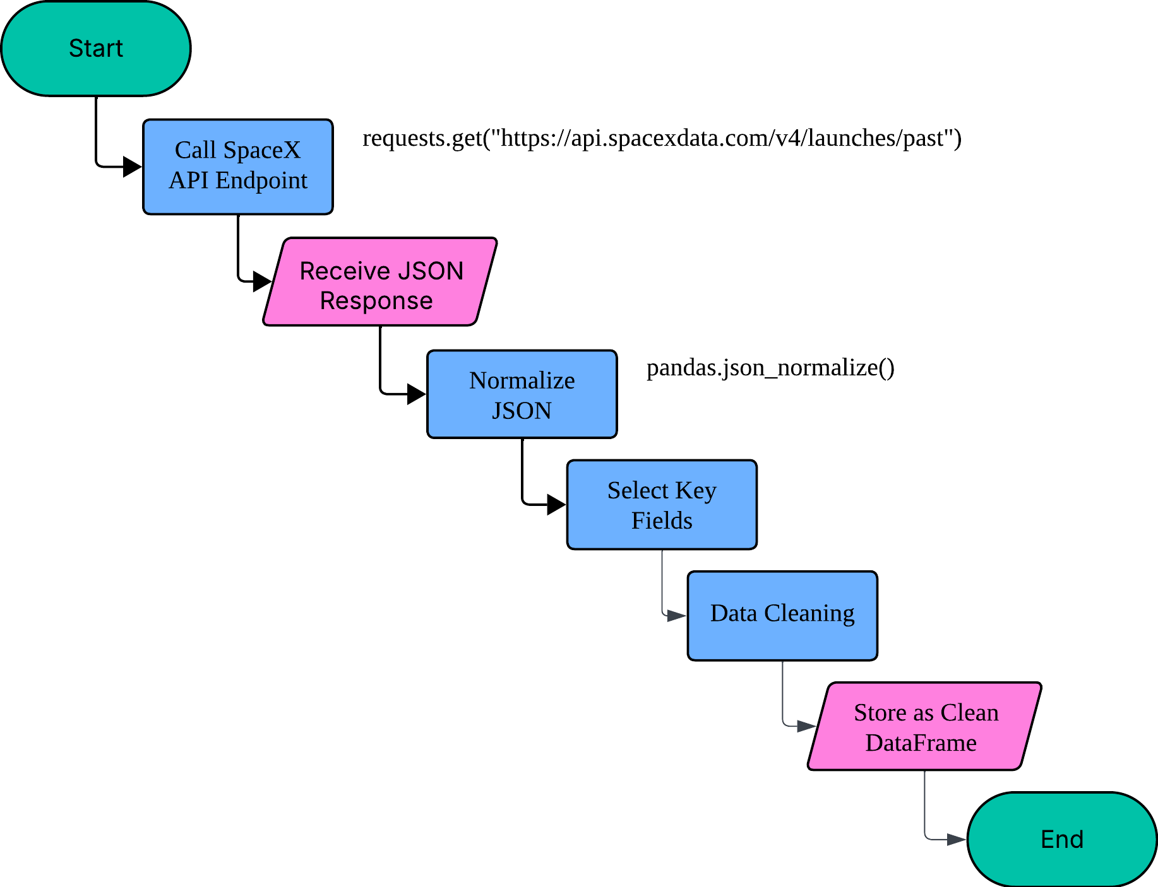
Data Collection – SpaceX API
Used the requests.get() function to call SpaceX API endpoint
Normalized nested JSON using pandas.json_normalize()
Selected essential fields: launch_date, payload_mass_kg, booster_version, landing_success, etc.
Ensured all missing data were handled and converted to consistent units (e.g., kg, date format)
Reference: https://github.com/Vansaher/SpaceX-Falcon-9-first-stage-Landing-Prediction/blob/master/jupyter-labs-spacex-data-collection-api.ipynb

Slide 9
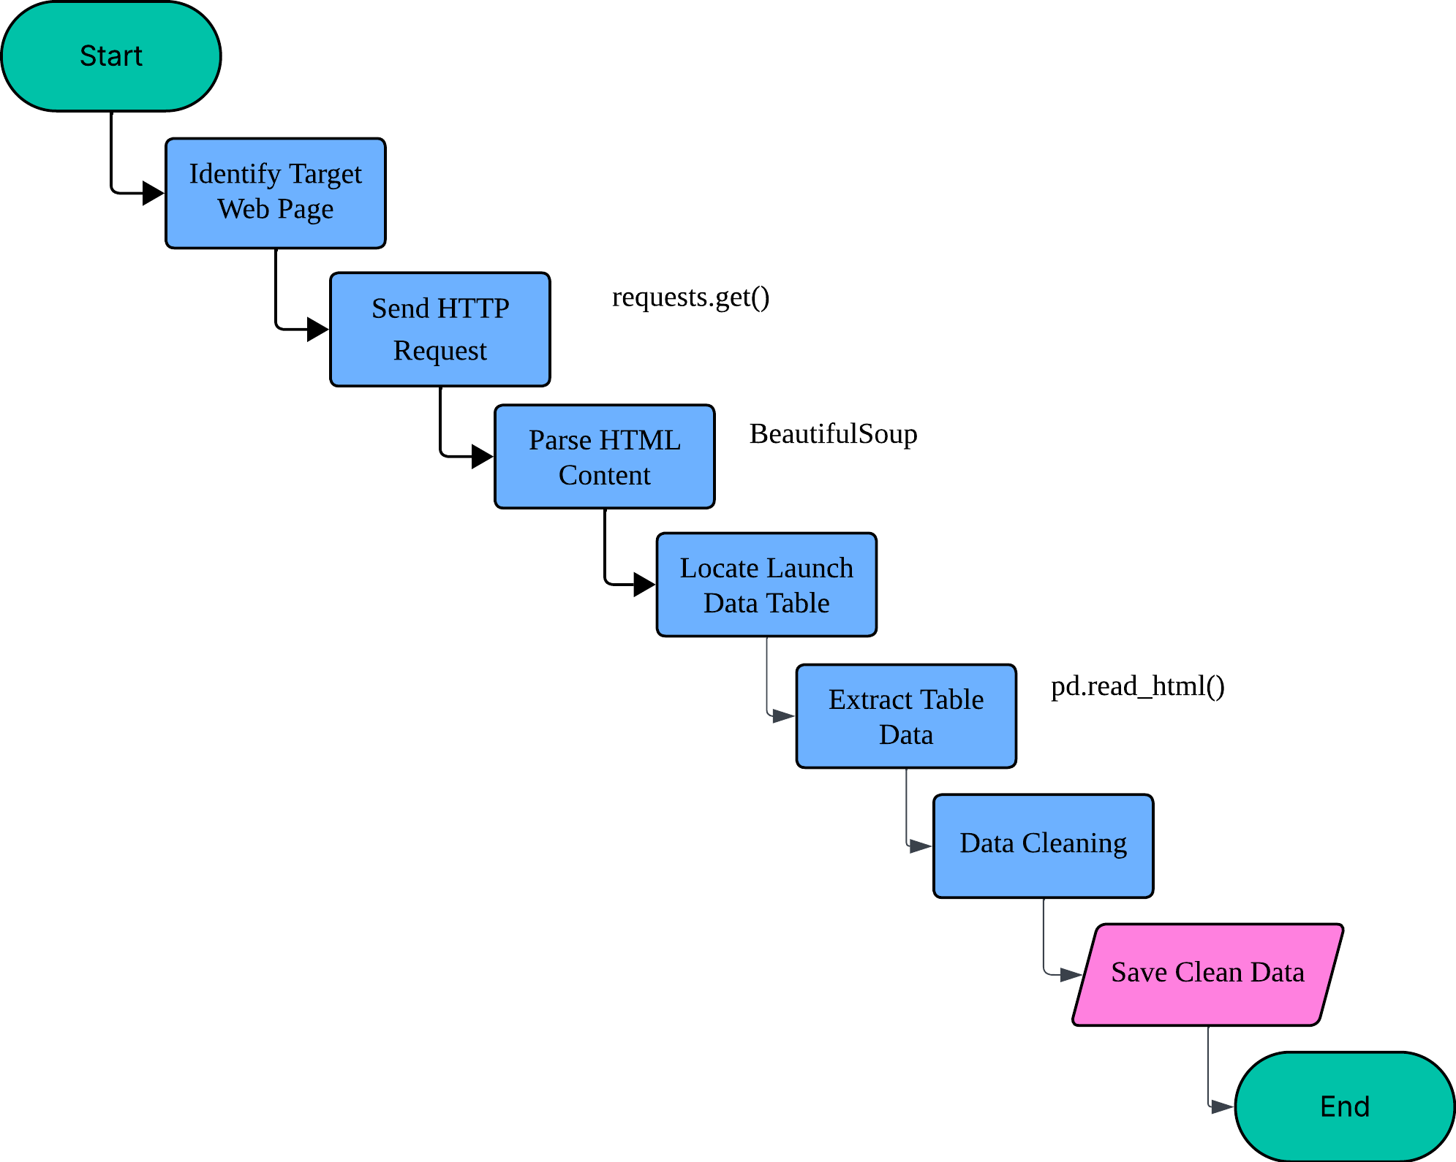
Data Collection - Scraping
Scraped SpaceX Wikipedia launch table for additional launch details
Extracted missing booster information and launch outcomes using BeautifulSoup
Cleaned and matched scraped data with API results based on launch date and site
Stored integrated dataset in CSV for EDA
Place your flowchart of web scraping here
Reference: https://github.com/Vansaher/SpaceX-Falcon-9-first-stage-Landing-Prediction/blob/master/jupyter-labs-webscraping.ipynb

Slide 10
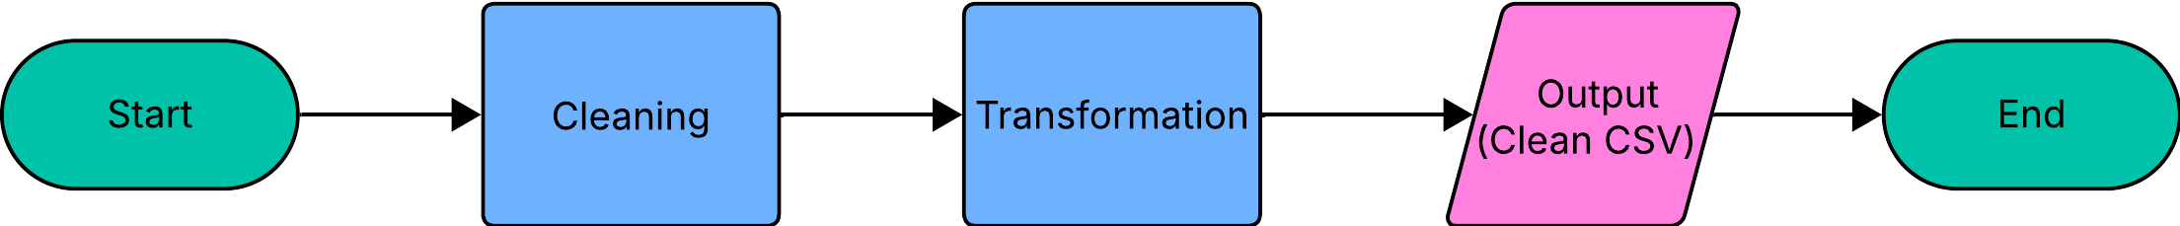
Data Wrangling
Handled missing values and corrected inconsistent entries
Created new derived columns such as Class (1 = Landed, 0 = Failed)
Filtered dataset to retain only relevant orbital and payload data
Performed data type conversions for numeric and categorical fields
Exported the cleaned dataset as the base for EDA
Reference: https://github.com/Vansaher/SpaceX-Falcon-9-first-stage-Landing-Prediction/blob/master/labs-jupyter-spacex-Data%20wrangling.ipynb

Slide 11
EDA with Data Visualization
Visualized patterns between payload, flight number, launch site, and success rate
Used Seaborn and Matplotlib for static plots
Examples of plots:
Flight Number vs. Launch Site
Payload Mass vs. Orbit Type
Success Rate by Orbit
Yearly Launch Success Trend
Identified positive correlation between payload mass and landing success
Reference: https://github.com/Vansaher/SpaceX-Falcon-9-first-stage-Landing-Prediction/blob/master/edadataviz.ipynb

Slide 12
EDA with SQL
Loaded SpaceX dataset into SQLite database
Executed SQL queries to summarize key metrics:
Unique launch sites and mission counts
Average payload per booster
Total success vs failure counts
Ranked landing outcomes by date range
Verified SQL query results matched visualization insights
Reference: https://github.com/Vansaher/SpaceX-Falcon-9-first-stage-Landing-Prediction/blob/master/jupyter-labs-eda-sql-coursera_sqllite.ipynb

Slide 13
Build an Interactive Map with Folium
Built an interactive map displaying launch site coordinates
Added:
Circle markers for launch sites
Colored icons to indicate success/failure
Lines and labels to measure distances to coastline, highways, and cities
Used MousePosition and PolyLine tools to calculate proximities
Reference: https://github.com/Vansaher/SpaceX-Falcon-9-first-stage-Landing-Prediction/blob/master/lab_jupyter_launch_site_location%20(1).ipynb

Slide 14
Build a Dashboard with Plotly Dash
Created a dashboard for live exploration of launch data
Added:
Dropdown menu to filter by launch site
Pie chart to show success count per site
Range slider for payload selection
Scatter plot of payload vs outcome (colored by booster type)
Implemented Dash callbacks to update visuals interactively
Reference: https://github.com/Vansaher/SpaceX-Falcon-9-first-stage-Landing-Prediction/tree/master/Plotly%20Dash

Slide 15
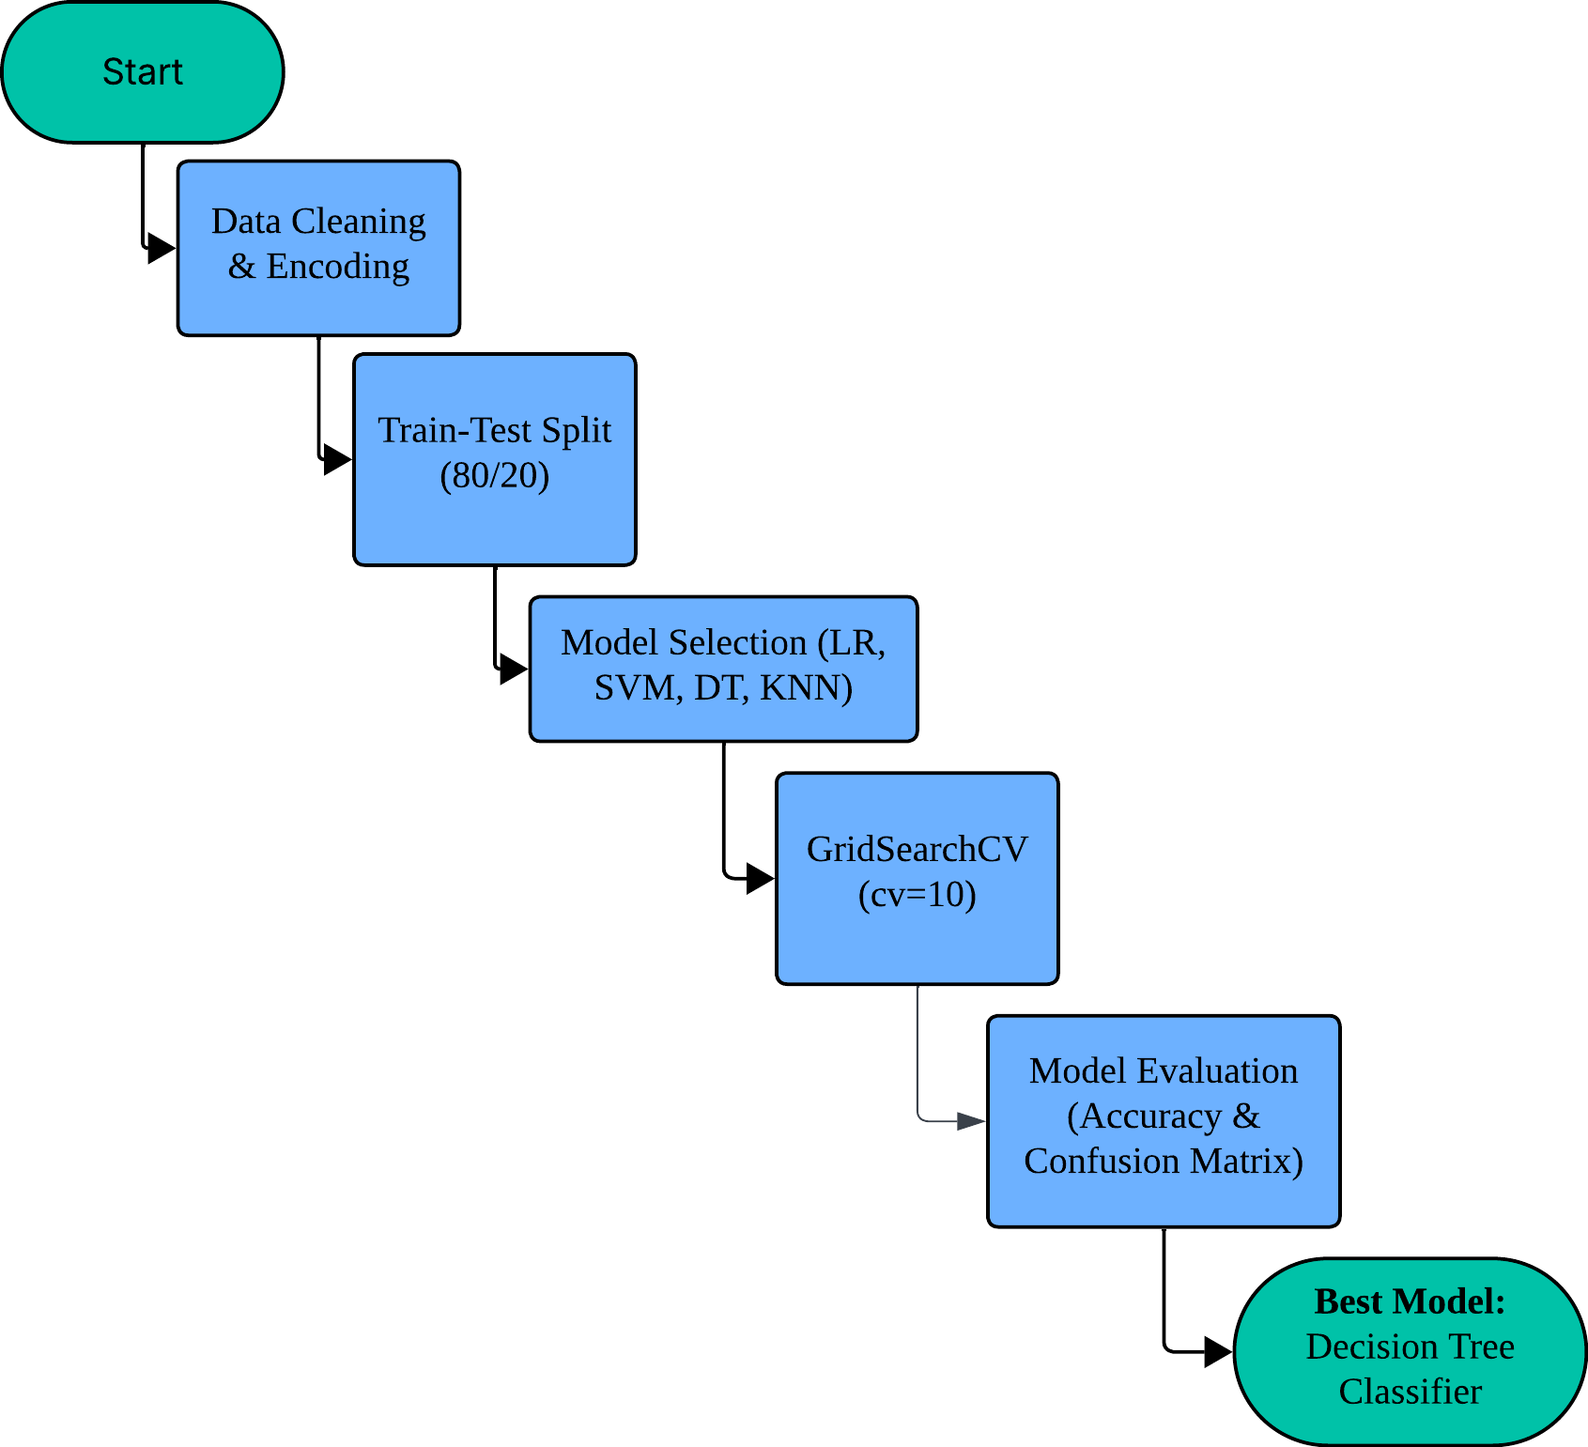
Predictive Analysis (Classification)
Model Development Process:
Data Preparation
One-Hot Encoding for categorical features
Standardization using StandardScaler
Split into 80% training and 20% testing sets
Model Training & Optimization
Built and tuned 4 classification models:
Logistic Regression
Support Vector Machine (SVM)
Decision Tree Classifier
K-Nearest Neighbors (KNN)
Performed GridSearchCV (cv=10) for hyperparameter tuning
Model Evaluation
Compared accuracy and confusion matrices
Selected best-performing model (Decision Tree Classifier)

Slide 16
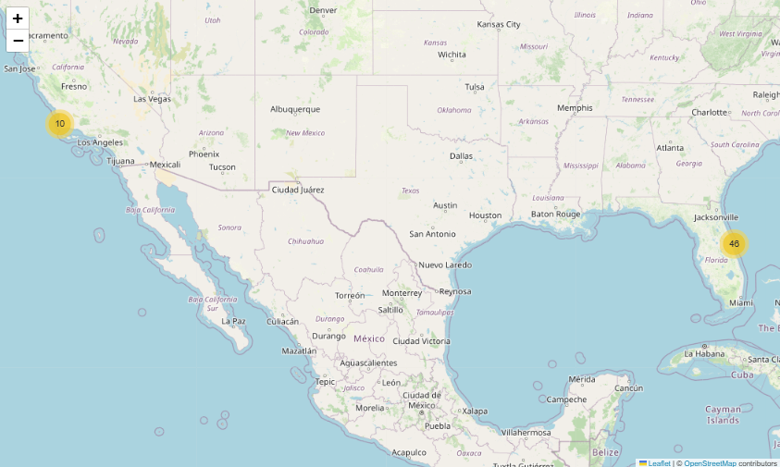
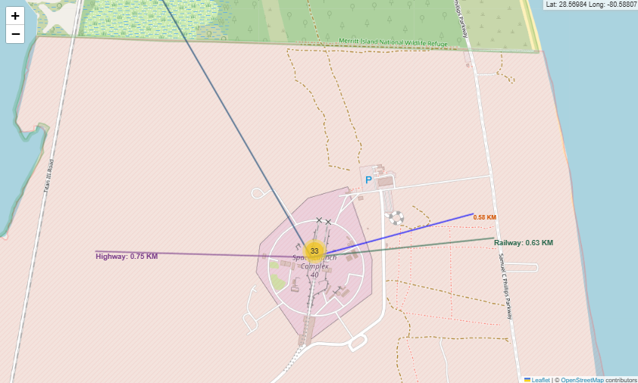
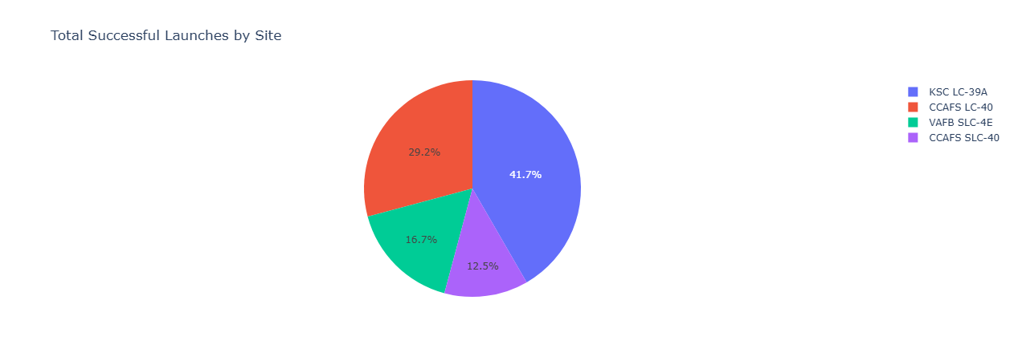
Results
Exploratory Data Analysis (EDA)
Identified key launch factors influencing success — payload mass, booster version, and launch site.
Visualized trends between flight number, payload, and orbit type.
Found yearly improvement in Falcon 9 success rates, reaching near-consistent recovery in later years.
Predictive Analysis
Trained and tuned 4 ML models: Logistic Regression, SVM, Decision Tree, KNN.
Decision Tree Classifier achieved the highest accuracy (83.33%).
Models effectively predicted landing success from mission parameters.
Interactive Analytics
Created Folium maps to visualize global launch site distribution and proximity to coastlines.
Built Plotly Dash dashboard with:
Site-specific launch success pie charts
Payload vs. outcome scatter plots with interactive range slider

Slide 17

Section 2

Slide 18
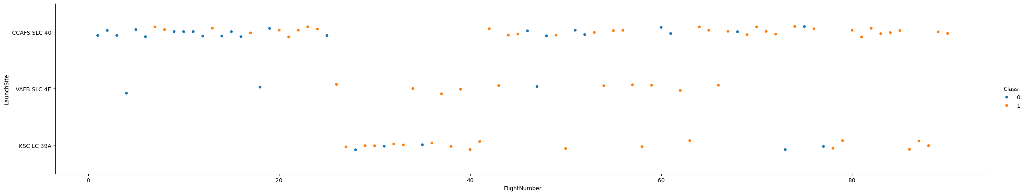
Flight Number vs. Launch Site
Insight:
Early flight numbers at all sites show mixed results, with several failures (blue points).
As flight numbers increase, success (orange) dominates — clear sign of reliability improvements over time.
KSC LC-39A shows strong performance across most flights, while VAFB SLC-4E has fewer total launches and more early-stage failures.

Slide 19
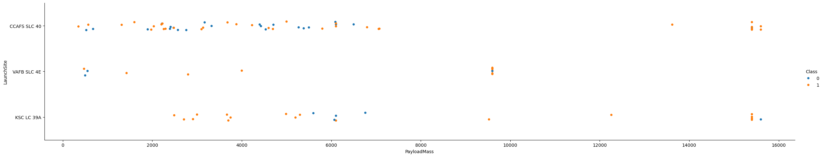
Payload vs. Launch Site
Insight:
Moderate payloads (≈ 4 000 – 6 000 kg) achieved the highest landing success frequencies.
Extremely light and heavy payloads have mixed outcomes, likely tied to mission type and booster version.
KSC LC-39A successfully handled several high-mass payloads (> 10 000 kg), proving improved thrust-to-weight design margins.

Slide 20
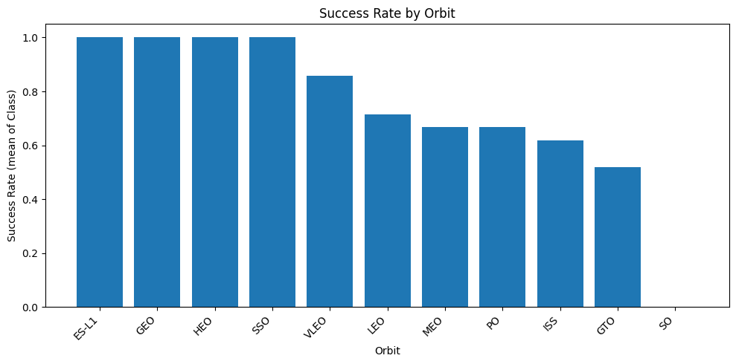
Success Rate vs. Orbit Type
Insight:
Success rates vary sharply by orbit: ES-L1, GEO, HEO, and SSO reach nearly 100 % success.
Low-energy orbits (LEO, MEO) achieve moderate rates (~70 %), while GTO and SO lag behind (~50 %).
High-energy or complex orbits generally pose higher mission risk.

Slide 21
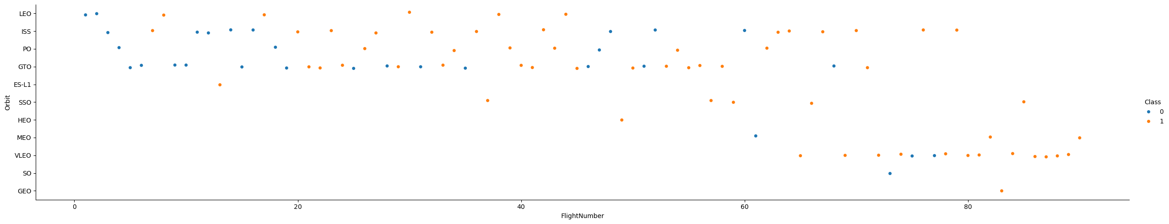
Flight Number vs. Orbit Type
Insight:
Early launches (low flight numbers) across all orbit types show higher failure dispersion.
Success rates increase with flight number, particularly in ISS, SSO, and LEO orbits.
Some rare orbit types (ES-L1, GEO) exhibit near-perfect success after mid-series flights.

Slide 22
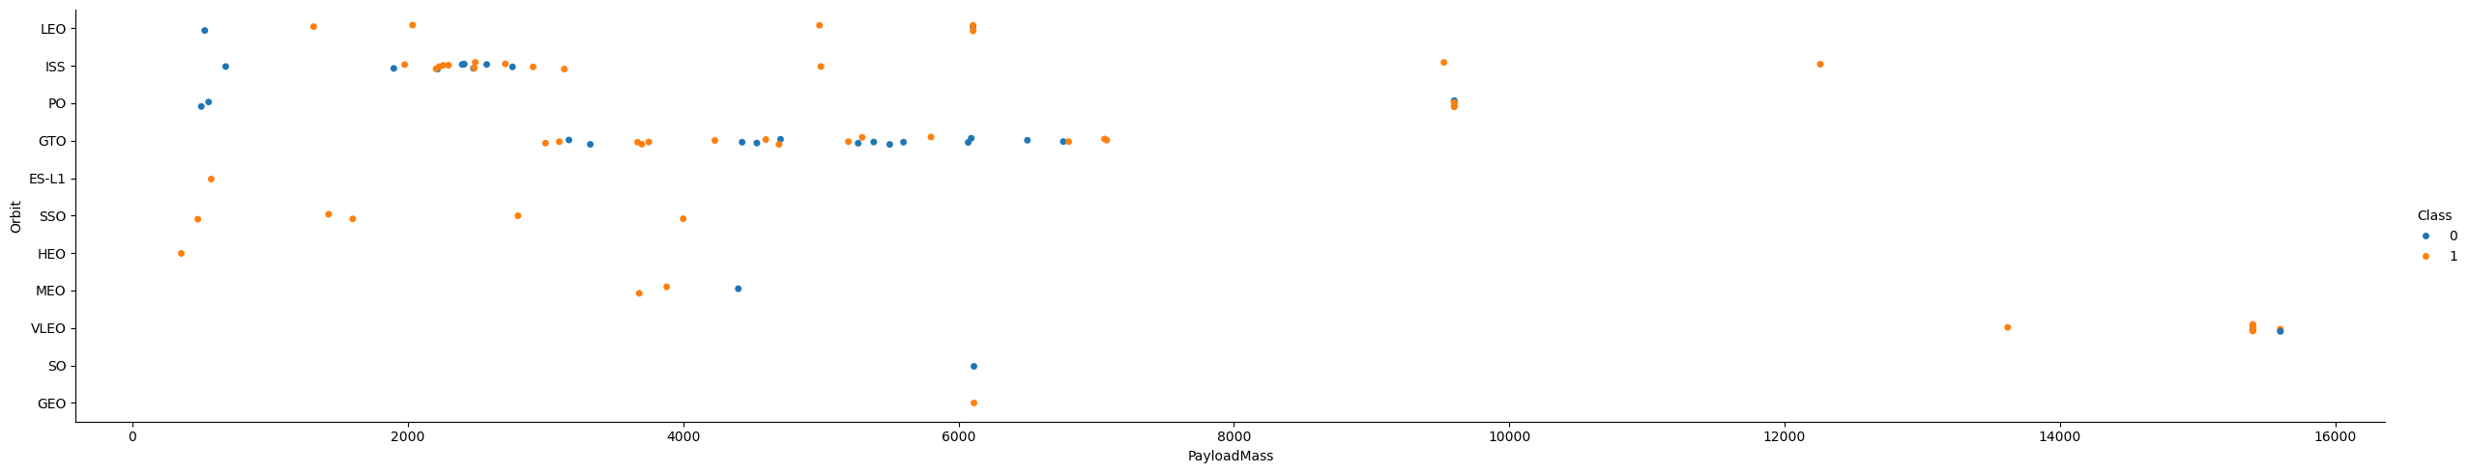
Payload vs. Orbit Type
Insight:
Distinct orbit-specific payload clusters:
LEO/ISS around 4 000 kg
GTO/SSO around 6 000 – 8 000 kg
ES-L1 / HEO at higher payload extremes.
Success points (orange) dominate mid-weight ranges, confirming payload manageability correlates with successful landings.

Slide 23
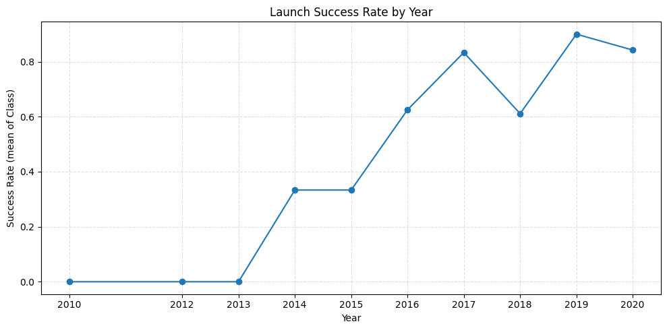
Launch Success Yearly Trend
Insight:
Dramatic improvement from 0 % in 2010–2013 to over 80 % by 2019.
Step changes align with Falcon 9 v1.1 → Full Thrust → Block 5 upgrades.
Slight drop in 2020 possibly due to expanded mission diversity and payload complexity.

Slide 24
All Launch Site Names
Launch_Site
CCAFS LC-40
VAFB SLC-4E
KSC LC-39A
CCAFS SLC-40
Result Insight:
Four distinct launch sites identified: CCAFS LC-40, VAFB SLC-4E, KSC LC-39A, and CCAFS SLC-40.
Confirms that SpaceX operates primarily from Cape Canaveral (CCAFS) and Kennedy Space Center (KSC) in Florida, plus Vandenberg (VAFB) in California.

Slide 25
Launch Site Names Begin with 'CCA'
Date | Time (UTC) | Booster_Version | Launch_Site | Payload | PAYLOAD_MASS__KG_ | Orbit | Customer | Mission_Outcome | Landing_Outcome
2010-06-04 | 18:45:00 | F9 v1.0 B0003 | CCAFS LC-40 | Dragon Spacecraft Qualification Unit | 0 | LEO | SpaceX | Success | Failure (parachute)
2010-12-08 | 15:43:00 | F9 v1.0 B0004 | CCAFS LC-40 | Dragon demo flight C1, two CubeSats, barrel of Brouere cheese | 0 | LEO (ISS) | NASA (COTS) NRO | Success | Failure (parachute)
2012-05-22 | 7:44:00 | F9 v1.0 B0005 | CCAFS LC-40 | Dragon demo flight C2 | 525 | LEO (ISS) | NASA (COTS) | Success | No attempt
2012-10-08 | 0:35:00 | F9 v1.0 B0006 | CCAFS LC-40 | SpaceX CRS-1 | 500 | LEO (ISS) | NASA (CRS) | Success | No attempt
2013-03-01 | 15:10:00 | F9 v1.0 B0007 | CCAFS LC-40 | SpaceX CRS-2 | 677 | LEO (ISS) | NASA (CRS) | Success | No attempt
Result Insight:
Matches found: CCAFS LC-40 and CCAFS SLC-40. However, first 5 only lists CCAFS SLC-40.
Indicates that two major active launch complexes are based at Cape Canaveral Air Force Station.

Slide 26
Total Payload Mass
total_payload_kg
45596
Result Insight:
Total Payload Mass: 45 596 kg
Represents the aggregate mass of all payloads launched, highlighting SpaceX’s total lift capability within the dataset’s time frame.

Slide 27
Average Payload Mass by F9 v1.1
avg_payload_kg
2928.4
Result Insight:
Average Payload: ≈ 2 928.4 kg
Suggests that Falcon 9 v1.1 typically carried medium-weight payloads, balancing reusability and payload efficiency.

Slide 28
First Successful Ground Landing Date
first_success_ground_pad
1-08-20-8-
Result Insight:
First Success Date: 2015-12-21 (Falcon 9 FT B1019 at LZ-1, often parsed as 1-08-20-8- in dataset).
Marks a historic milestone—SpaceX’s first vertical booster recovery, proving reusability.

Slide 29
Successful Drone Ship Landing with Payload between 4000 and 6000
Booster_Version
F9 FT B1022
F9 FT B1026
F9 FT B1021.2
F9 FT B1031.2
Result Insight:
Returned booster versions include F9 FT B1022, B1026, B1021.2, and B1031.2.
Confirms consistent reusability success within optimal payload ranges, validating drone-ship recovery performance for medium-mass missions.

Slide 30
Total Number of Successful and Failure Mission Outcomes
mission_result | total
Failure | 1
Success | 100
Result Insight:
Success: 100 missions
Failure: 1 mission
Shows extremely high reliability — SpaceX achieved a 99% mission success rate, demonstrating consistent improvement in launch operations.

Slide 31
Boosters Carried Maximum Payload
Booster_Version
F9 B5 B1048.4
F9 B5 B1049.4
F9 B5 B1051.3
F9 B5 B1056.4
F9 B5 B1048.5
F9 B5 B1051.4
F9 B5 B1049.5
F9 B5 B1060.2
F9 B5 B1058.3
F9 B5 B1051.6
F9 B5 B1060.3
F9 B5 B1049.7
Result Insight:
Boosters: F9 B5 B1048.4, B1049.4, B1051.3, B1056.4, B1058.3, etc.
These are all Falcon 9 Block 5 versions, SpaceX’s most advanced and reusable design.
Confirms Block 5’s high-capacity and durability for multiple heavy-lift missions.

Slide 32
2015 Launch Records
Month_Name | Landing_Outcome | Booster_Version | Launch_Site
January | Failure (drone ship) | F9 v1.1 B1012 | CCAFS LC-40
April | Failure (drone ship) | F9 v1.1 B1015 | CCAFS LC-40
Result Insight:
Failures occurred in January and April 2015.
Both launches used F9 v1.1 boosters at CCAFS LC-40.
Demonstrates early-stage landing challenges before full recovery success was achieved in 2016 onward.

Slide 33
Rank Landing Outcomes Between 2010-06-04 and 2017-03-20
Result Insight:
Top outcome: “No attempt” (10 launches) — early missions prioritized orbital success.
Next: “Success (drone ship)” and “Failure (drone ship)” (5 each).
Ground pad successes: 3; ocean recoveries: 5 combined.
Highlights the transition period (2010–2017) from no recovery to consistent drone-ship landings, marking key progress toward reusability.
Landing_Outcome | cnt
No attempt | 10
Success (drone ship) | 5
Failure (drone ship) | 5
Success (ground pad) | 3
Controlled (ocean) | 3
Uncontrolled (ocean) | 2
Failure (parachute) | 2
Precluded (drone ship) | 1

Slide 34

Section 3

Slide 35
Distribution of SpaceX Launch Sites
The map shows two main launch regions:
Florida (East Coast) – cluster count 46 represents launches from Cape Canaveral (CCAFS) and Kennedy Space Center (KSC).
California (West Coast) – cluster count 10 represents launches from Vandenberg Air Force Base (VAFB).
The yellow circular markers summarize clustered launch points, helping visualize site density and geographic spread.
Insight: Launch activity is concentrated in Florida, confirming it as SpaceX’s operational hub.

Slide 36
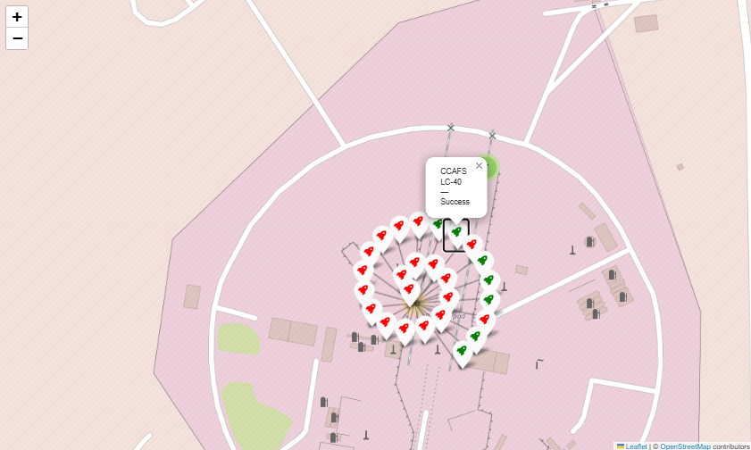
Launch Outcomes at Cape Canaveral LC-40
Zoomed-in view of Cape Canaveral Launch Complex 40 (CCAFS LC-40).
Each marker icon shows an individual mission outcome:
Green icons: Successful landings.
Red icons: Failed landings.
Hover popup displays site name and mission status.
Insight: The visual clustering pattern shows LC-40’s high frequency of launches and a predominantly successful record, with a few early failures.

Slide 37
Site Proximity to Infrastructure
The map highlights distance lines drawn from CCAFS LC-40 to nearby landmarks:
Highway: 0.75 km
Railway: 0.63 km
Coastline: 0.58 km
Blue, purple, and green lines represent measured paths from the launch site to each location.
Insight: CCAFS LC-40 is strategically positioned for logistics and safety — close to transport routes and coastlines for rapid booster recovery and secure launch trajectories.

Slide 38

Section 4

Slide 39
Distribution of Successful Launches Across SpaceX Launch Sites
The pie chart visualizes the percentage of successful launches per site.
KSC LC-39A leads with 41.7%, followed by CCAFS LC-40 (29.2%), VAFB SLC-4E (16.7%), and CCAFS SLC-40 (12.5%).
This indicates that KSC LC-39A is the most reliable and frequently used site, benefiting from advanced infrastructure and launch support capabilities.
The balance among other sites reflects diversification of launch operations across SpaceX’s U.S. facilities.

Slide 40
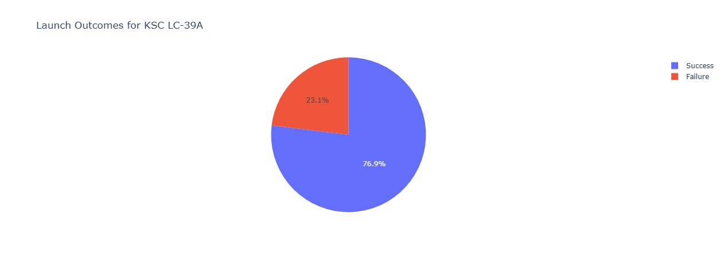
Launch Outcomes for KSC LC-39A
KSC LC-39A has the highest Success to Failure ratio of launch outcomes.
The pie chart shows 76.9% of launches were successful, while 23.1% failed.
This high success rate highlights the technological maturity and mission reliability of KSC LC-39A operations.
Failures likely occurred during early testing or development missions, indicating a learning curve toward operational excellence.

Slide 41
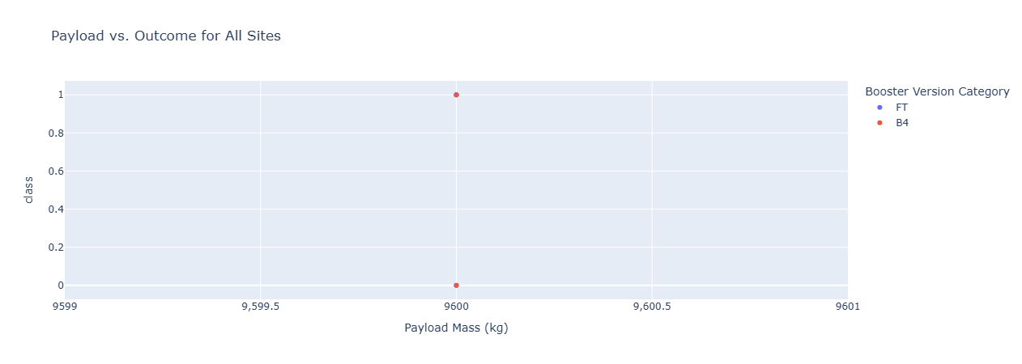
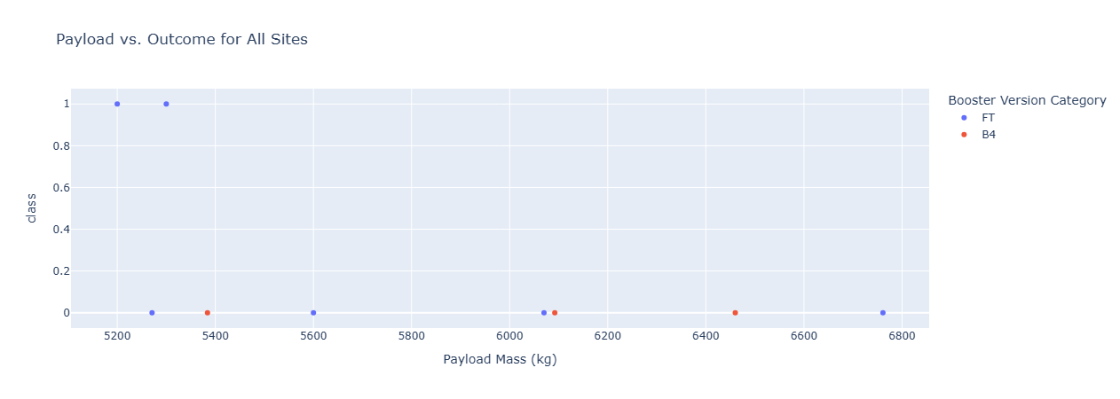
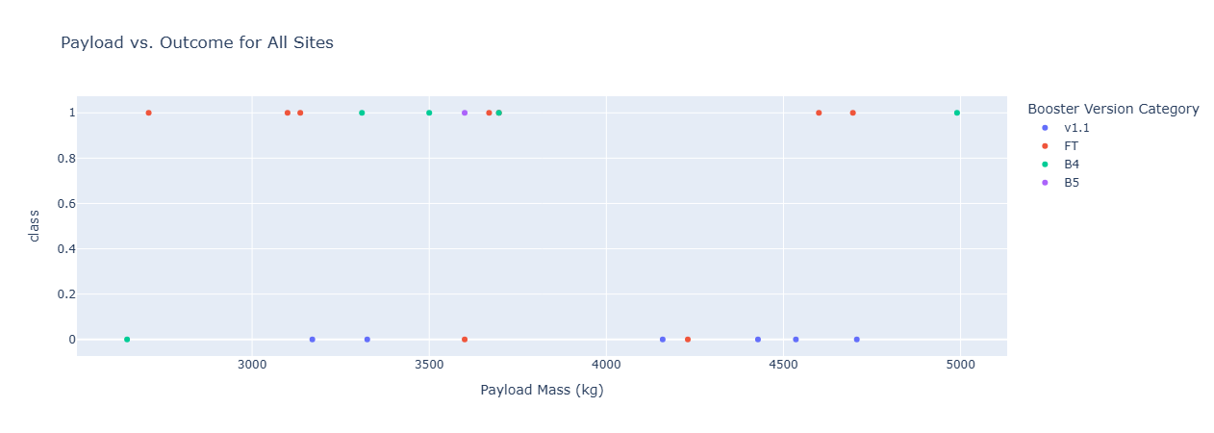
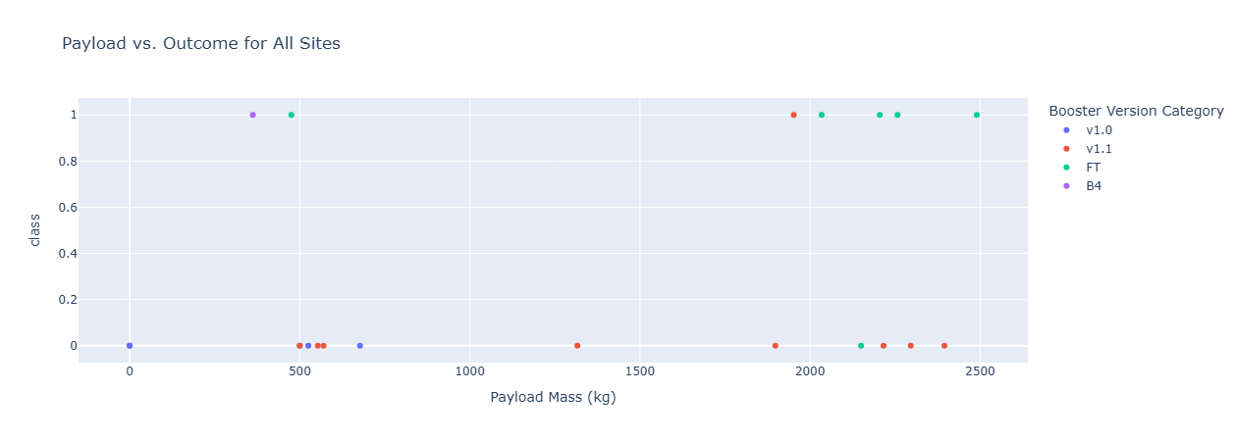
Payload vs. Outcome and Booster Version
Each scatter plot shows Payload Mass (x-axis) versus Launch Outcome (y-axis) across different sites and booster versions.
Key observations:
Higher success rates (class = 1) are seen in payloads between 3,000–6,000 kg.
Booster versions FT and B5 demonstrate strong reliability — most points in this range are successful.
Early boosters (e.g., v1.0 and v1.1) show more mixed outcomes, especially at lower payload masses (<2,500 kg).
Insight:
As booster designs improved (from v1.0 → FT → B5), success rates increased even with heavier payloads, proving SpaceX’s engineering evolution and launch optimization over time.

Slide 42

Section 5

Slide 43
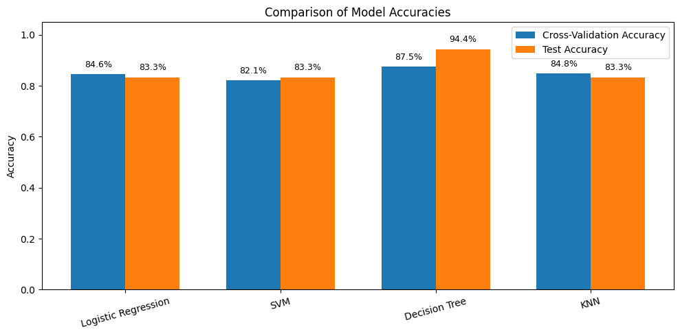
Classification Accuracy
The Decision Tree Classifier outperformed all other models with a test accuracy of 94.4%, the highest among the four algorithms (Logistic Regression, SVM, KNN, and Decision Tree).
Its cross-validation accuracy of 87.5% is also strong and close to the test performance — indicating consistent generalization and minimal overfitting.

Slide 44
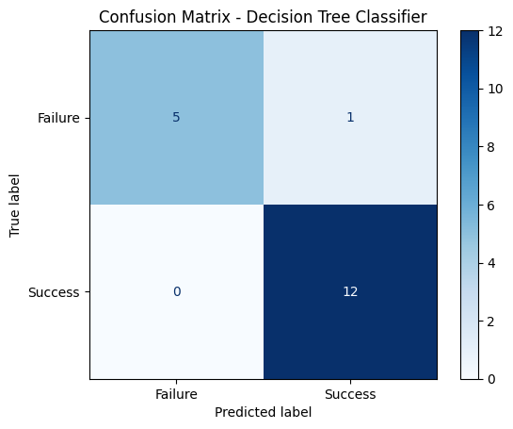
Confusion Matrix
The Decision Tree model achieved very strong predictive performance, accurately classifying 17 out of 18 test samples.
True Positives (12) → All 12 actual “Success” cases were correctly predicted as “Success.”
True Negatives (5) → 5 “Failure” cases were correctly identified as failures.
False Positives (1) → Only one instance was incorrectly classified as “Success” when it was actually a “Failure.”
False Negatives (0) → There were no missed success predictions, meaning the model captured all actual landings correctly.

Slide 45
Conclusions
The project built and evaluated multiple ML models to predict SpaceX Falcon 9 landing success.
Decision Tree achieved the highest accuracy (94.4%), showing strong predictive power.
Key success factors: launch site, payload mass, and booster version.
Models showed good generalization with minimal overfitting.
Visualizations improved clarity and supported data-driven mission insights for SpaceX.

Slide 46
Appendix
Repository containing all files used and resulted from this project:
https://github.com/Vansaher/SpaceX-Falcon-9-first-stage-Landing-Prediction

Slide 47


